Slide 1
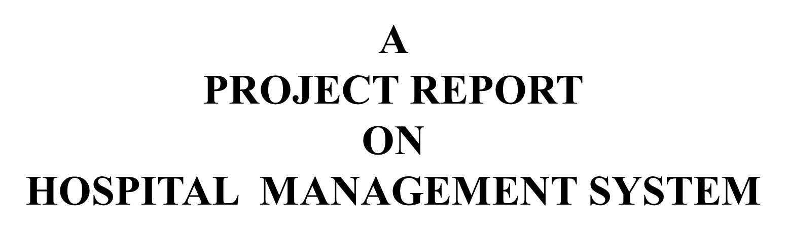


Slide 2

Hospital management system is a frontier science integrating medicine, information, management, computer and other disciplines. It has been widely used in developed countries and has created good social and economic benefits. Hospital management system is the necessary technical support and infrastructure for modern hospital operation. The purpose of realizing hospital management system is to strengthen hospital management by more modern, scientific and standardized means, to improve hospital work efficiency and medical quality, so as to establish a new image of modern hospital.

Slide 3

Function brief
功能简介
Interface display
界面展示
1
2

Slide 4
Function brief
功能简介

Slide 5
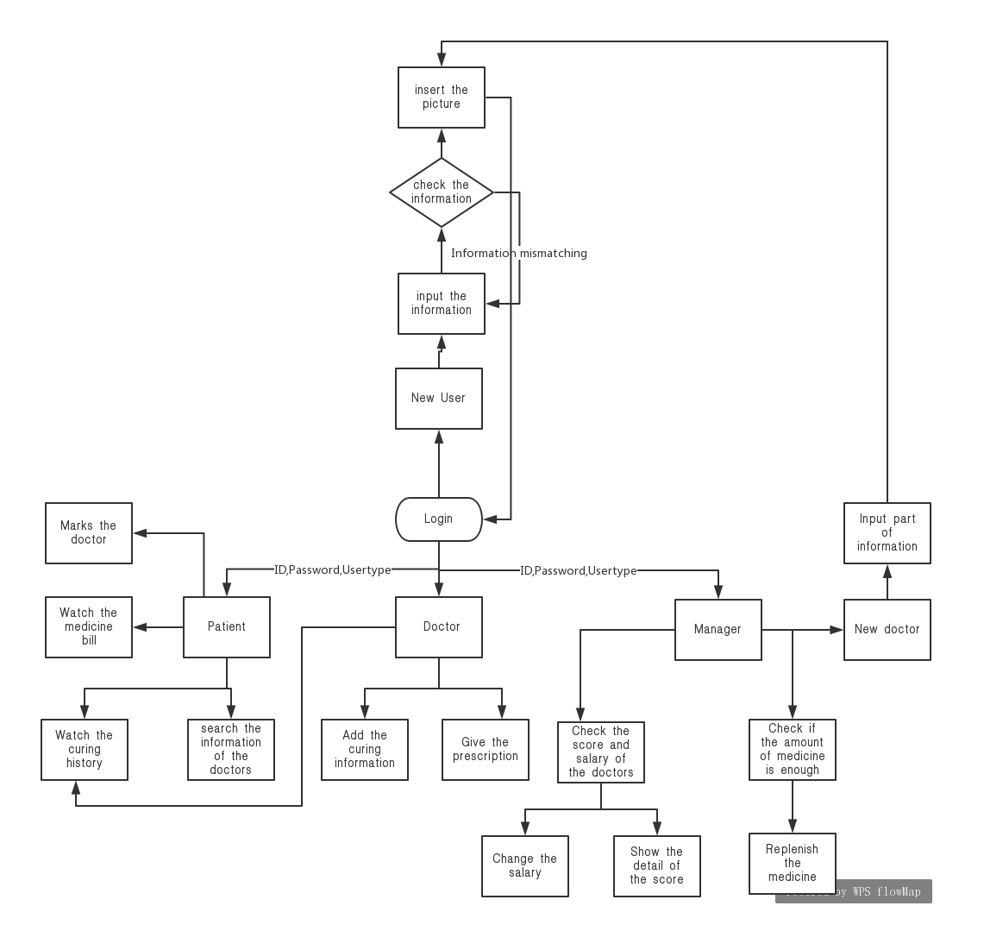


Slide 6
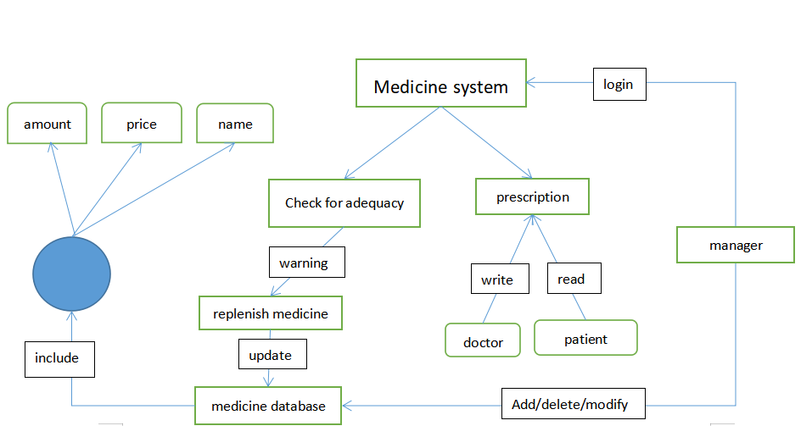
Drug management module
药品管理模块

Slide 7
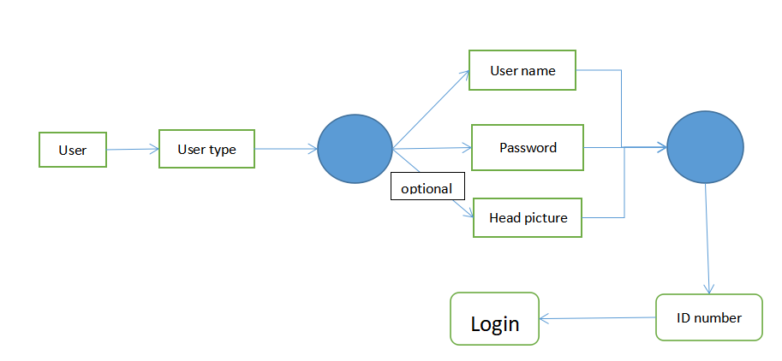
Login module
登录模块

Slide 8
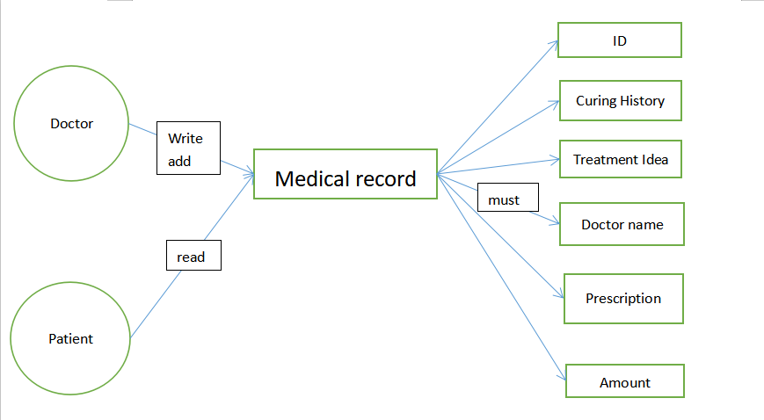
Medical record management module
病历管理模块

Slide 9
Registration module
注册模块

Slide 10
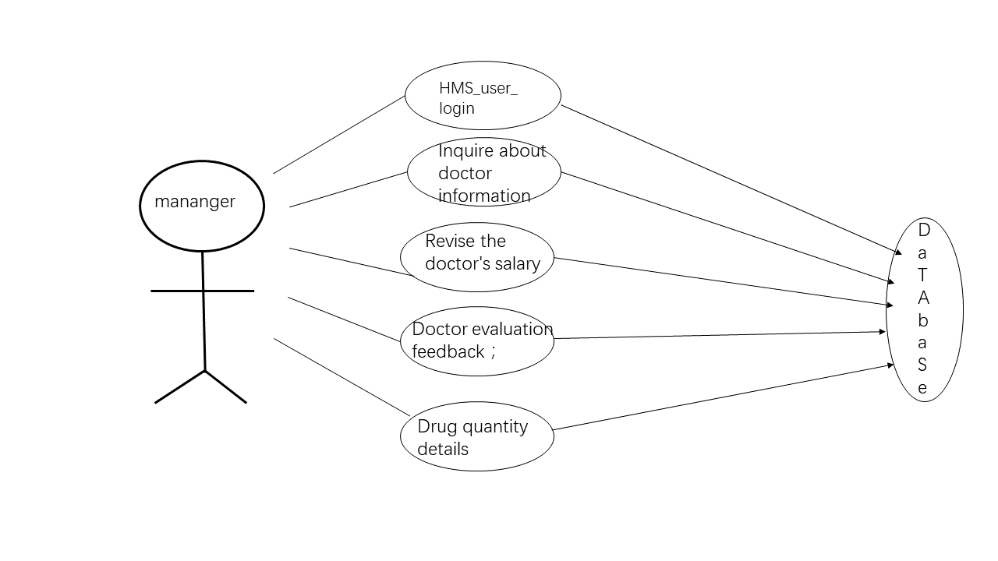
manager module
管理人员模块

Slide 11
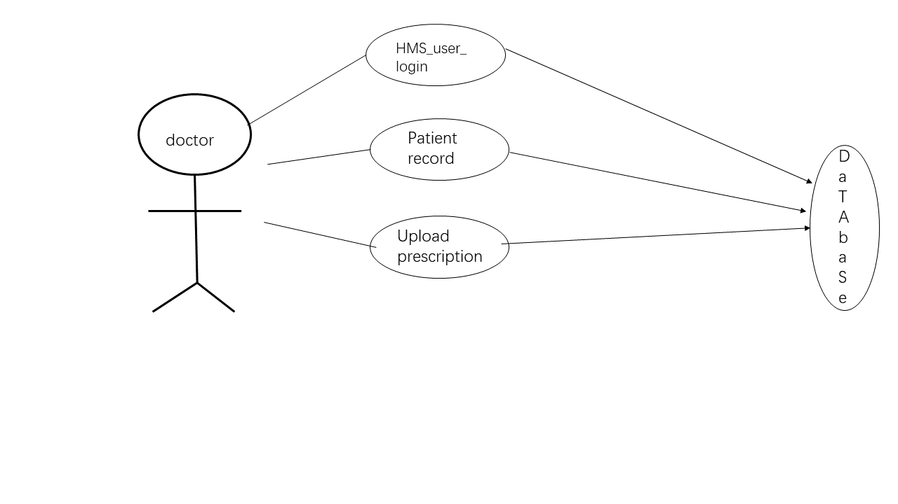
Doctor module
医生模块

Slide 12
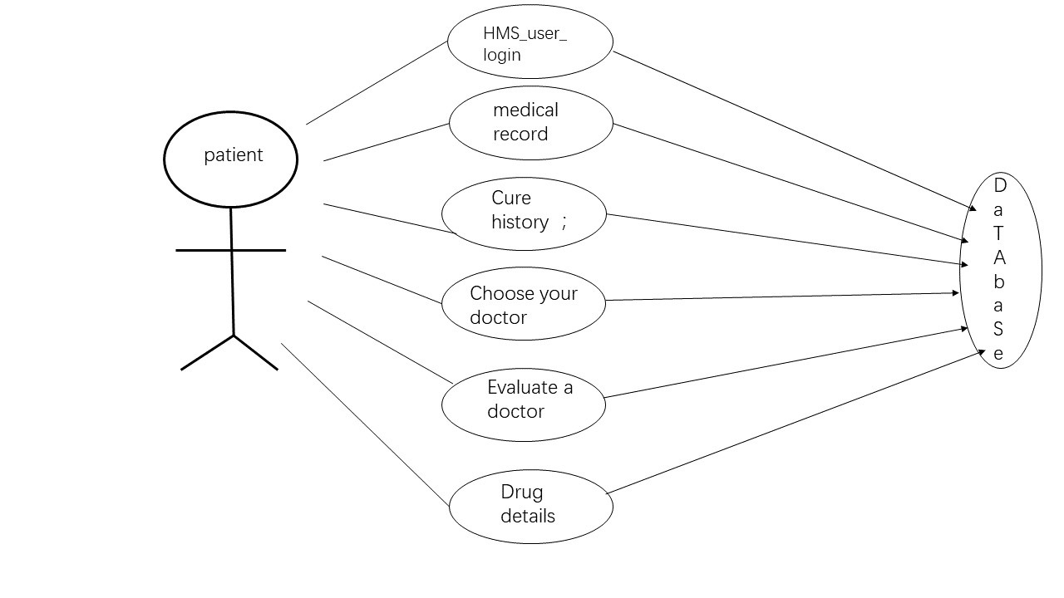
Patient module
病人模块

Slide 13
Interface display
界面展示

Slide 14
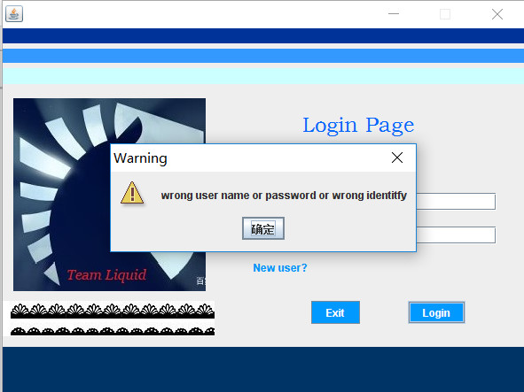
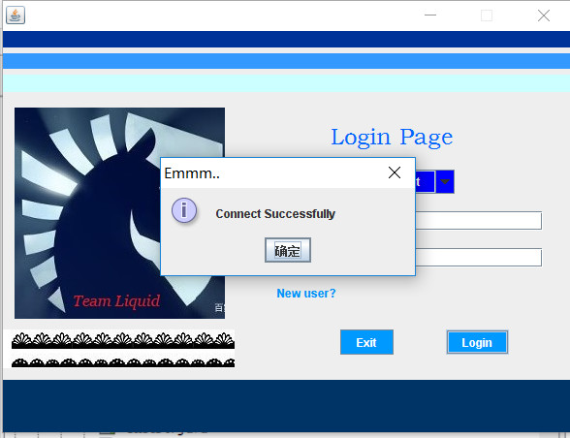

login
interface
PPT模板下载：www.1ppt.com/moban/

Slide 15
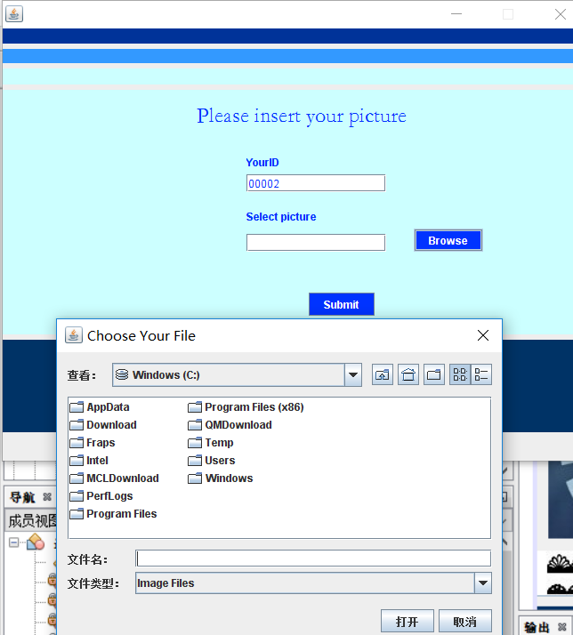
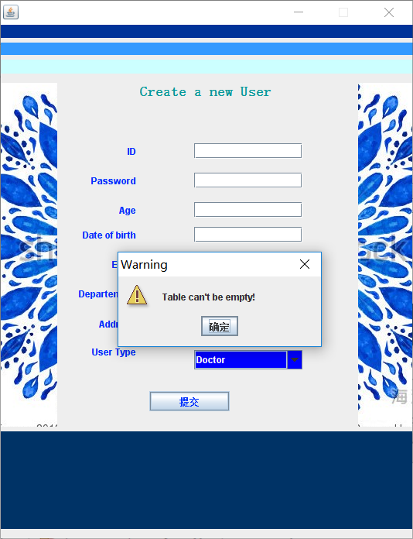
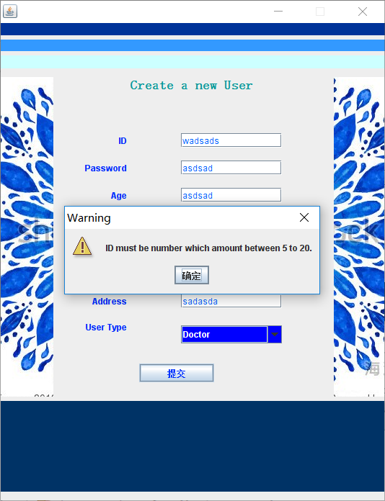
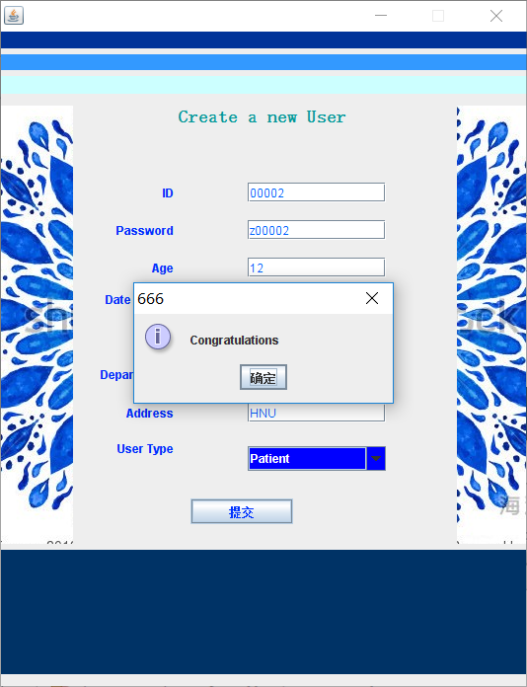
newuser
interface

Slide 16
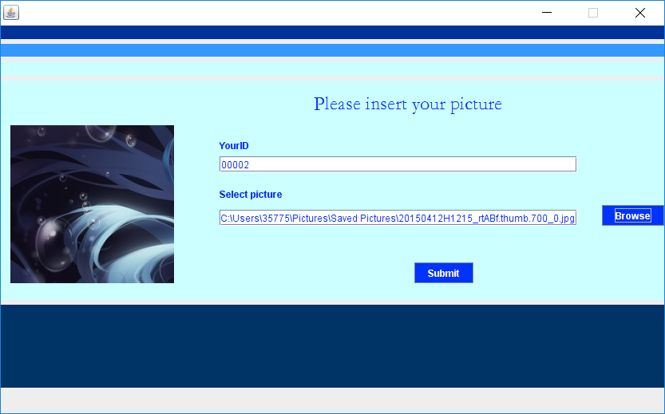
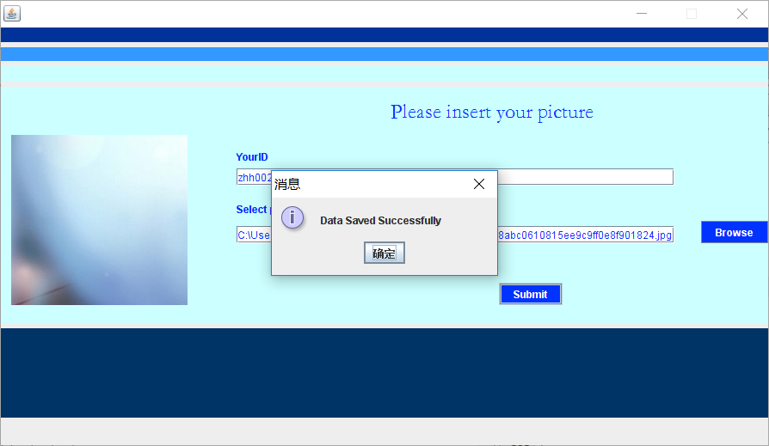
Create a new user

Slide 17
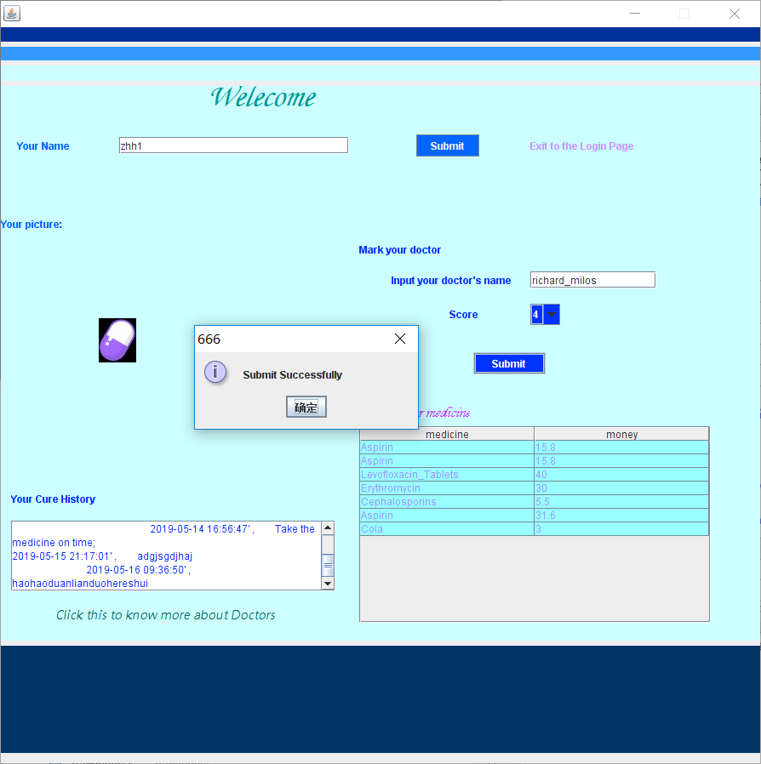
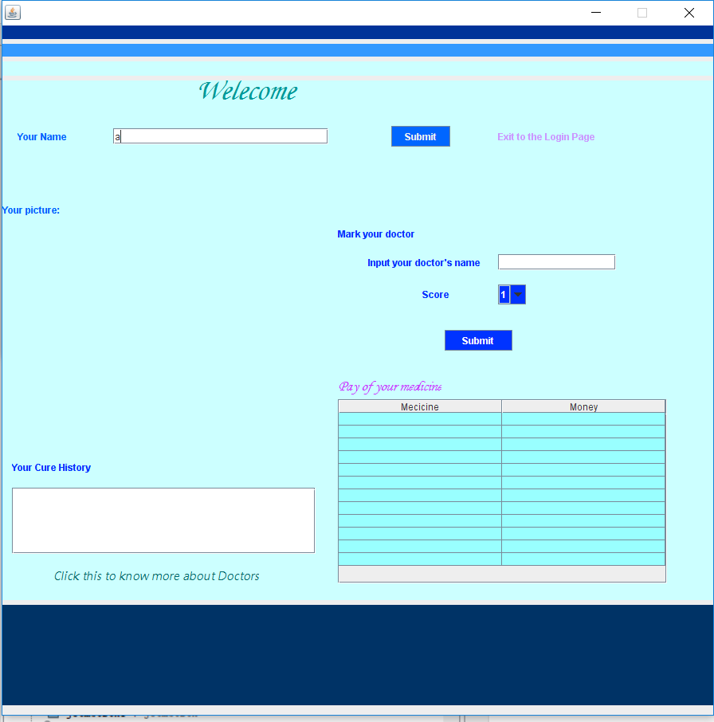
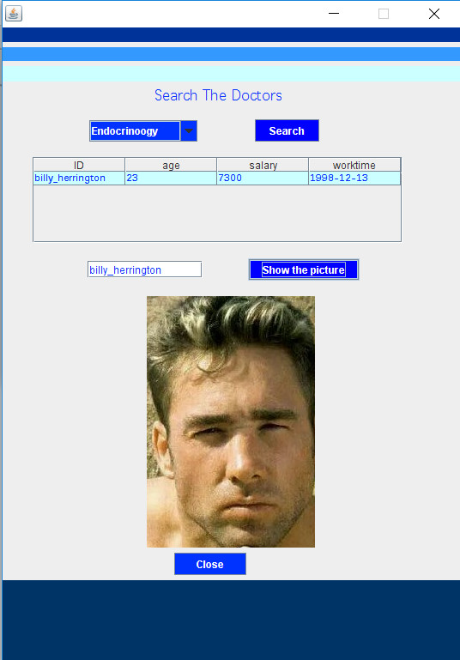
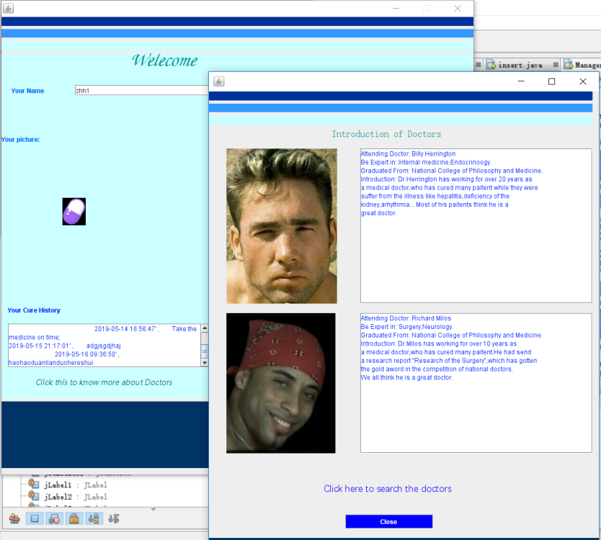
Patient login
interface

Slide 18
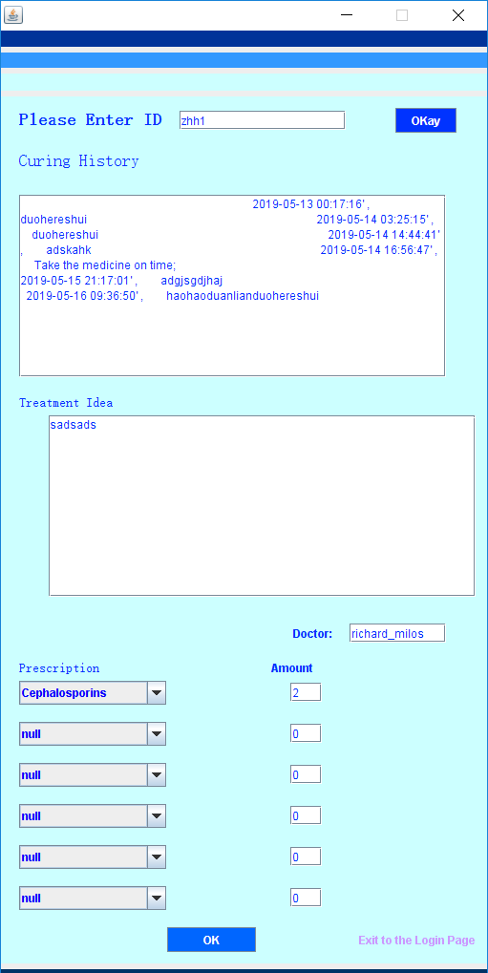
Doctor login interface

Slide 19
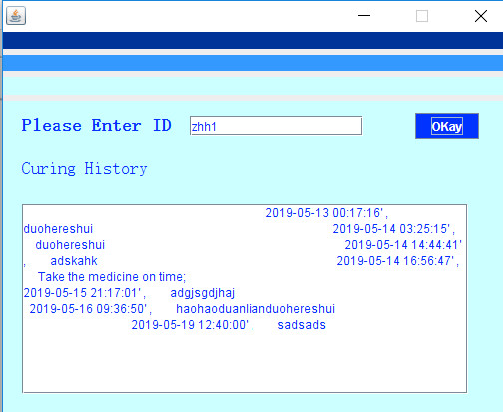
Provide function for patients
electronic medical record
电子病历

Slide 20
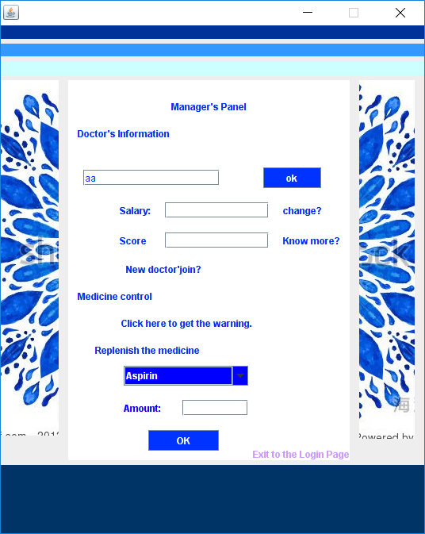
manager
interface
Manage doctor's salary and pharmacy
管理医生和药库

Slide 21

manager
interface
Manage doctor's salary and pharmacy
管理医生和药库

Slide 22
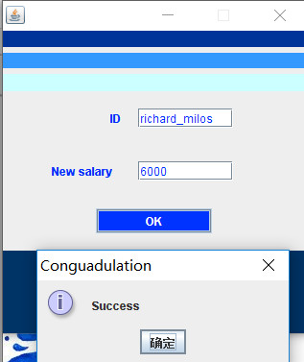
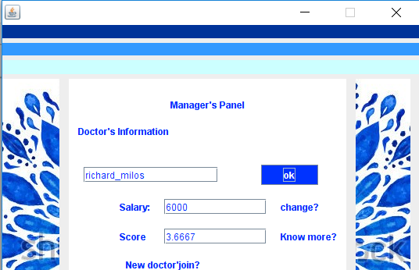
manager
interface
Manage doctor's salary and pharmacy
管理医生和药库

Slide 23
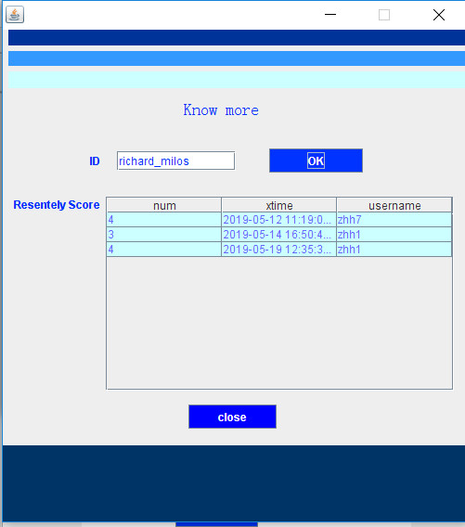
Provide function for manager
Know about the score
了解医生得分的详细情况

Slide 24
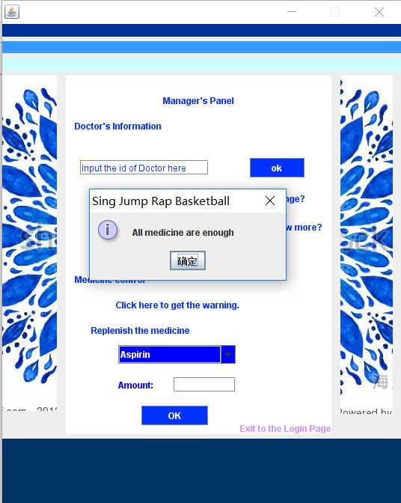
manager
interface
Manage doctor's salary and pharmacy
管理医生和药库

Slide 25

!
THANKS!
联系我
新浪微博：

